Slide 1

EDUKALP
AR/VR based Extended Reality Applications
for educational purposes,
personality development and mental health awareness.

Slide 2
1
Problem Statement
2
Objective
CONTENTS
3
Product Design Prototype
4
Marketability and Future Prospects

Slide 3

Problem Statement
Since the big game of advanced technology has come into play, the world of AI and ML has reached to the top scores of the game whereas AR/VR has been the underdog in the play. AR/VR industry is turning into a $94.4 Billion market by 2023.
But, where do we exactly stand in the use of AR/VR technologies in our daily lives ?
We need AR/VR technologies to simplify our lives through different applications. And there is no better way to commence than simplifying our educational sector, especially for students.
There has not been a revolutionary change in the educational sector for a long period of time at a large scale.
Thus, we chose the topic AR/VR – A concept that would support and improve education system and methods using extended reality. The app would also feature extended package skills for personality development and mental health awareness.

Slide 4

Objective
Our primary objective is to create extended reality applications using Unity 3D for students to make learning more riveting, increasing conceptual understanding and most importantly - enjoyable.
1
2
Using Vuforia Engine in Unity 3D, we mapped our models to an AR target to perform its functions such that when a person runs the application, the extended reality comes alive and that person can experience the 3D learning.
3
Also, we implemented GoogleVR SDK and Cardboard using which the user can interact with the virtual environment (with the help of gaze interaction).

Slide 5
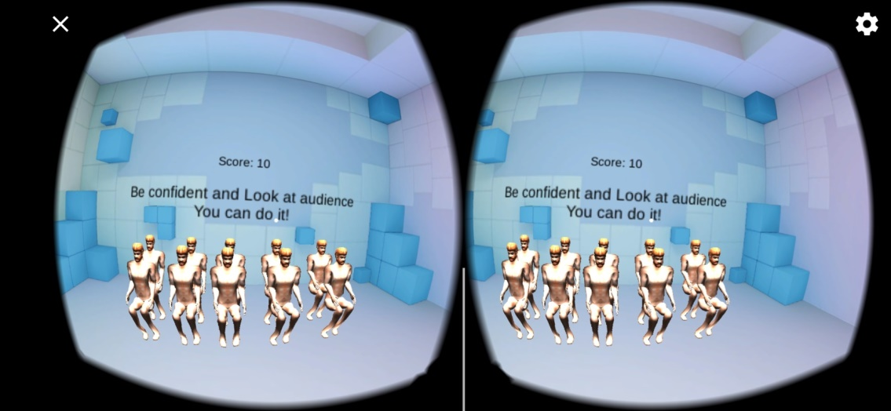
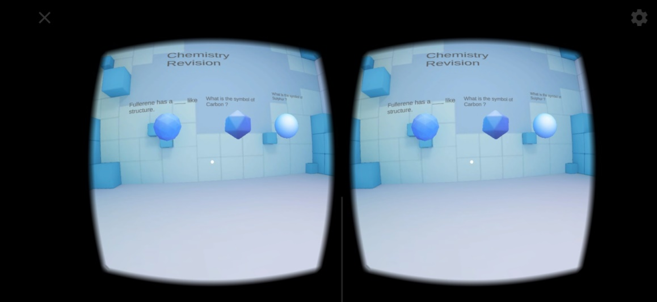
Product Design Prototype
1) Public Speaking
Teenagers and adults would be able to practice public speaking which will enhance their social personality and overall development. Stage fear can be easily overcome using this feature.
2) Periodic Table
Students would be to learn periodic table in the fun way through some visual concepts and facts about each element. The various periodic trends and facts would be taught in the most simplest way possible.

Slide 6
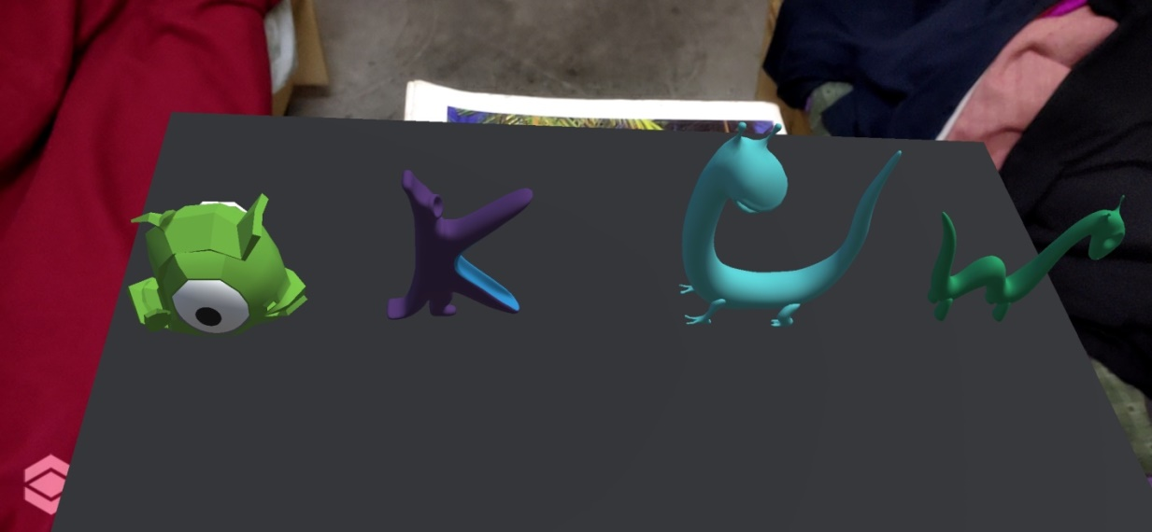
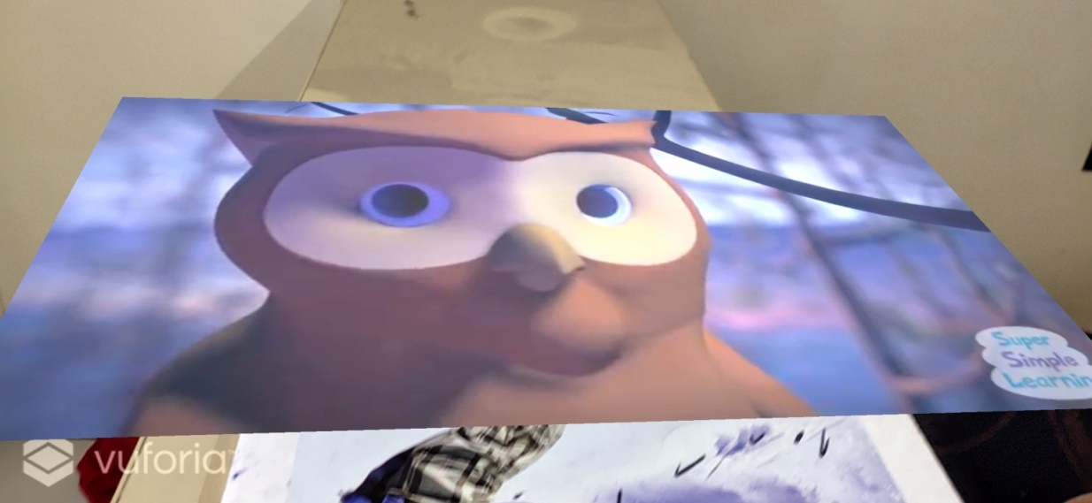
Product Design Prototype
3) Alphabets
This feature is especially designed for kids up to age of 4. This feature will promote interactive learning through 3D animation characters and sounds in the most efficient way possible.
4) Learning through AV and animation
There is nothing better than learning anything through videos whether the material is a poem, story or any other academic content.

Slide 7
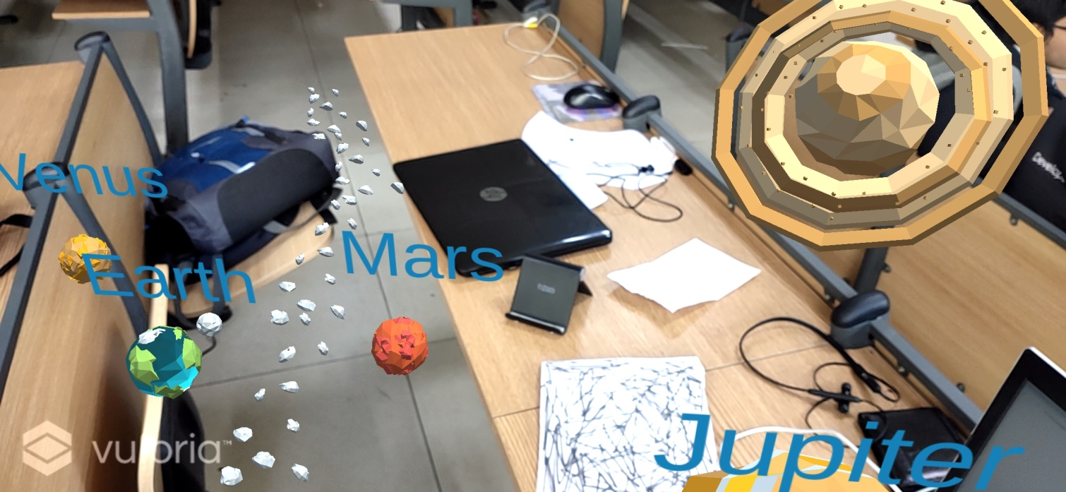
Product Design Prototype
5) Solar System
Students will be able to familiarize with the reality of our solar system and how it actually looks like in space. This would help in better visual understanding.

Slide 8
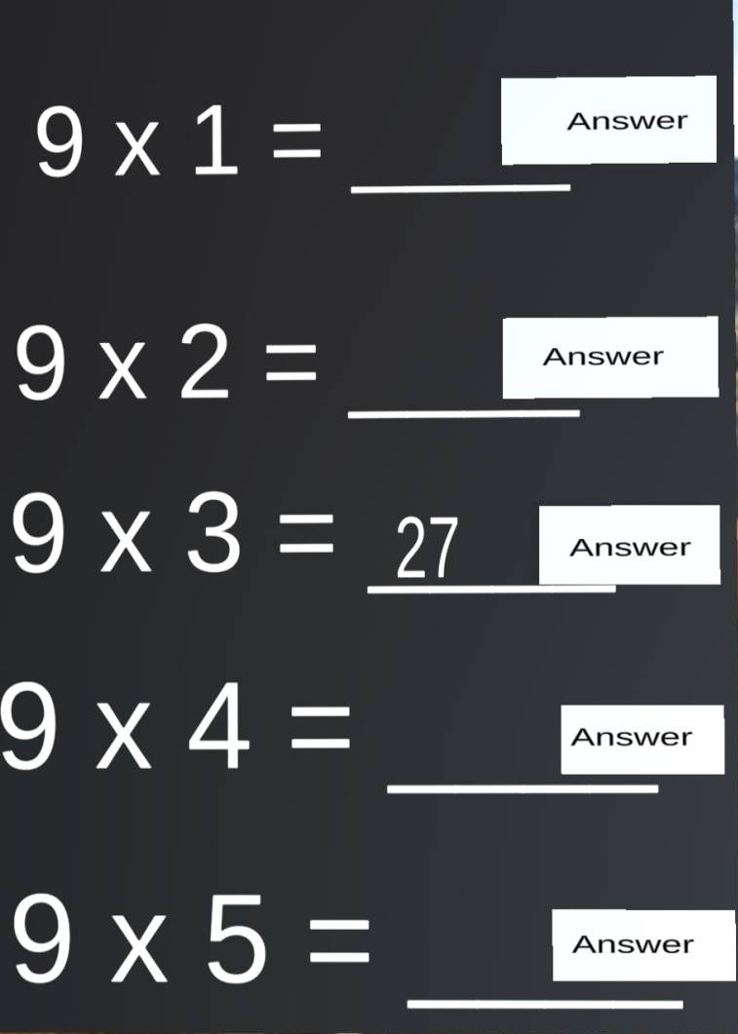
Product Design Prototype
6) Mathematics Tables Practice
Students, especially below the age of 10 would be able to practice multiplication tables virtually with ease. Similar AR-VR based applications can be developed for addition, subtraction and division operations.

Slide 9


Product Design Prototype
7) Speech Recognizer and Translator:
Students would be able to translate their spoken phrases into multiple languages, thus helping them to learn foreign languages’ basics.
8) Mental Health Monitor Skill: (As a suite of apps)
Users would be able to monitor their mental health with the developed Alexa skill. User would go through a series of questionnaire which would conclusively provide the next step needed by the user for better mental health.

Slide 10
AR-VR Market Statistics
70-75%
88%
70-75% of people aged 16-44 are aware of AR/VR tech.
88% of mid-sized companies are already using AR in some capacity.
3000+
73% of mobile AR-VR users reported either high or very high satisfaction with mobile AR-VR experiences.
Over 3000 AR-focused start-ups are listed on Angel List.
73%

Slide 11
Marketability and
Business Model
In 2020 the revenue for VR/AR educational software would be around $300 million and this figure is expected to grow to $700 million by 2025.
Development
As investments continue to rise, the quality of content improves and the cost of hardware decreases, the technology would be now accessible to educational institutes worldwide.
The developed application will be sold online on various platforms, especially on the educational ones. The apps would also be integrated with pre-existing educational models such as BYJU’s, Unacademy etcetera. Also, the app would be released as a suite which includes Alexa skill for mental health monitoring.
Consumer Interplay
It would help students take a step away from memorization and exams and allow them to learn through active participation and experience. It’s important that the educational institutions study aspects of AR and VR technology to find the right tools to make the difference in the learning experience of students.
Feedback

Slide 12
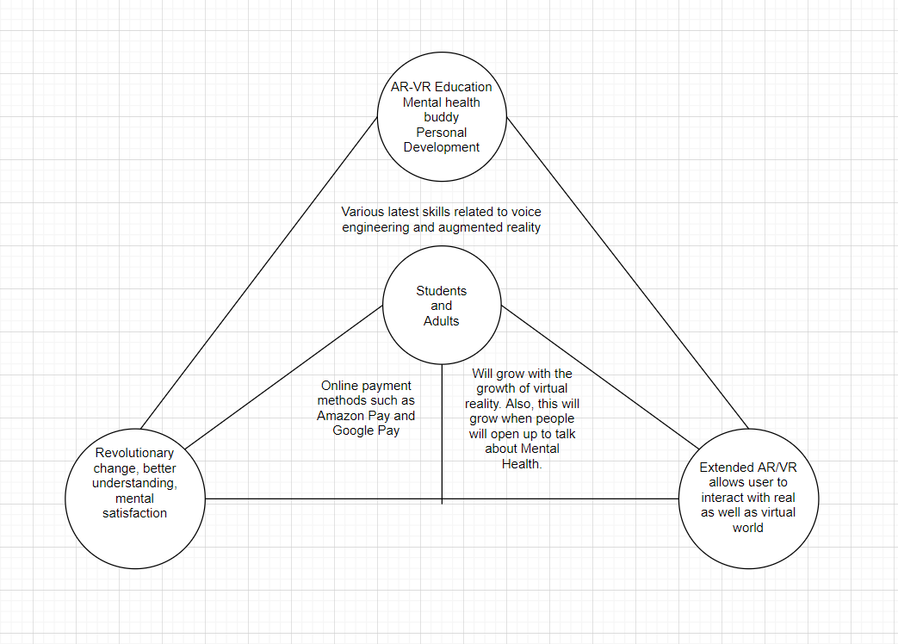
Business Model

Slide 13

Future Prospects
How AR-VR technology can change the world ?
We probably aren’t aware of the masterpieces we can create with AR/VR technologies. But we do need to understand that, rather than giving mobile to kids and teenagers for unworthy purposes, why don’t we use it for educational purposes. Although there are apps that teach different subjects but there’s not a single better tool than hands-on learning using AR/VR technology.
Also, we can add Alexa skills as a package to the whole app which would specifically trigger skills related to mental health.
Thus, not only it would encourage study on a whole new different platform, it will also introduce us to the world of AR/VR – a new generation technology.

Slide 14
Thank You!

